Slide 1





People's View on AI and
Workforce Transition Prediction
TEAM:
Leader - Manav Shah
Vatsal Shah
Satyam Singh
Nisarg Pujara
Ridham Patel
Team Id - 1926

Slide 2
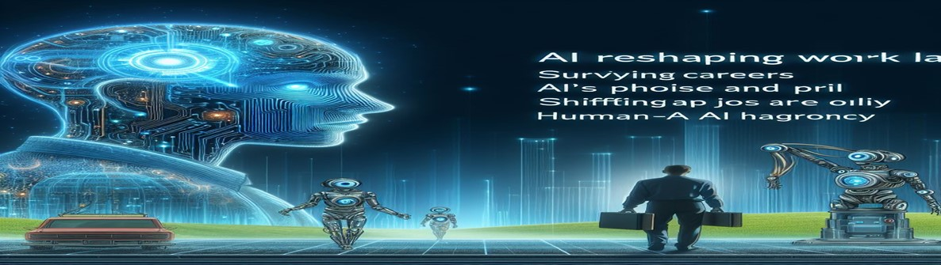
Project Objectives
Problem Statement
Project Overview – Introduction
End Users
Wow Factor in Project
Modelling/Block Diagram/Flow of Project
Result/outcomes
Conclusion
Future Perspective

Slide 3
Problem Statement
As AI reshapes our work landscape, everyone is concern about how AI can impact their job in the future and also many people are totally scared of the AI. Which slices through the fog of uncertainty. We’re surveying a kaleidoscope of careers to capture how AI touches lives and livelihoods. Through the lens of ML, we’ll chart the shifting sands of jobs and AI impact. We are showcasing AI’s dual role as a change and a catalyst for human .

Slide 4
Project overview - Introduction
As the beginning of our project, first we have taken review of 50 people about their views on "AI and the impact of AI on their respective field".
We have also asked their opinion about that, does AI increase their productivity?
We have also provided the prediction to the user, about how many chances are there of their job can be take over by the AI with the ML model .
At the end, model will also suggest the user that how they can cope up with the AI.
We have also provided the comparison about how much AI impact on such field and how much productivity increased

Slide 5
Here is the link of our survey form . So let's look into it.
Form

Slide 6



End User
Student
Job Analyst
Different profession

Slide 7
Wow Factor in Solution
We are providing prediction about AI impact on job roles with higher accuracy .
It merges large-scale data analysis (ML) with real-world experiences, creating a compelling narrative.
We are also showcasing the comparision on Impact of AI and productivity increasad

Slide 8
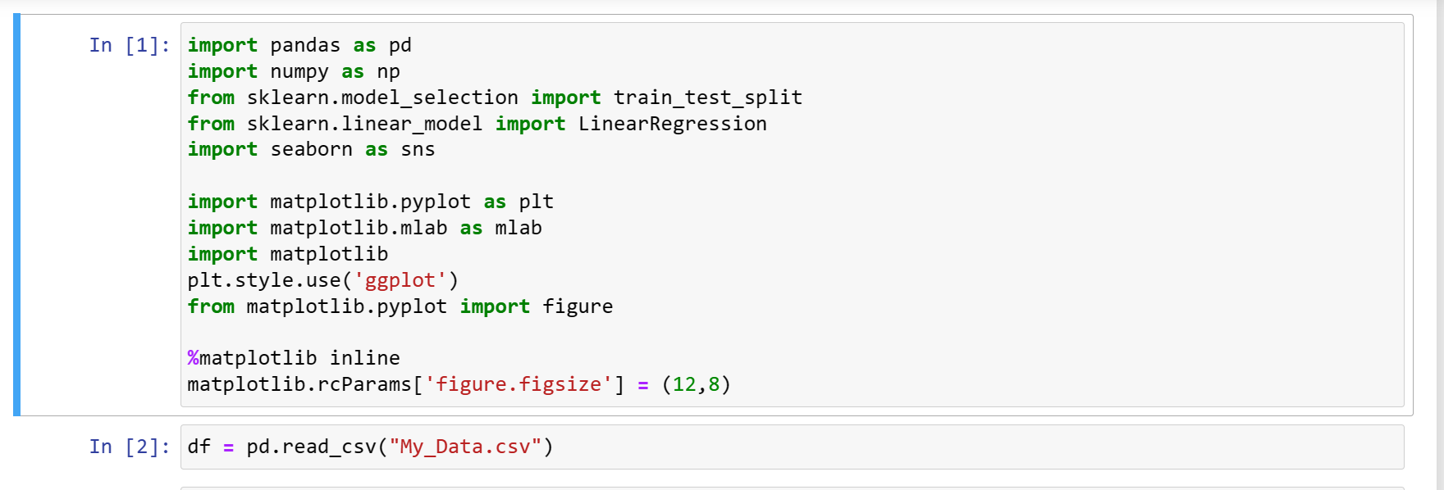
Modelling
Firstly we have imported all the libraries needed for the execution of the model.

Slide 9
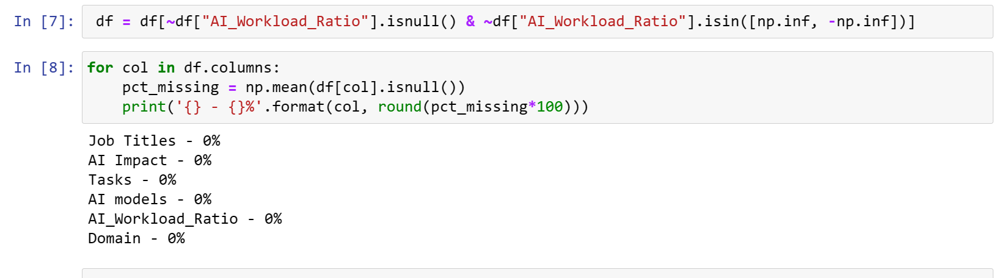
Then we have cleaned up the data so null values are adjusted.

Slide 10
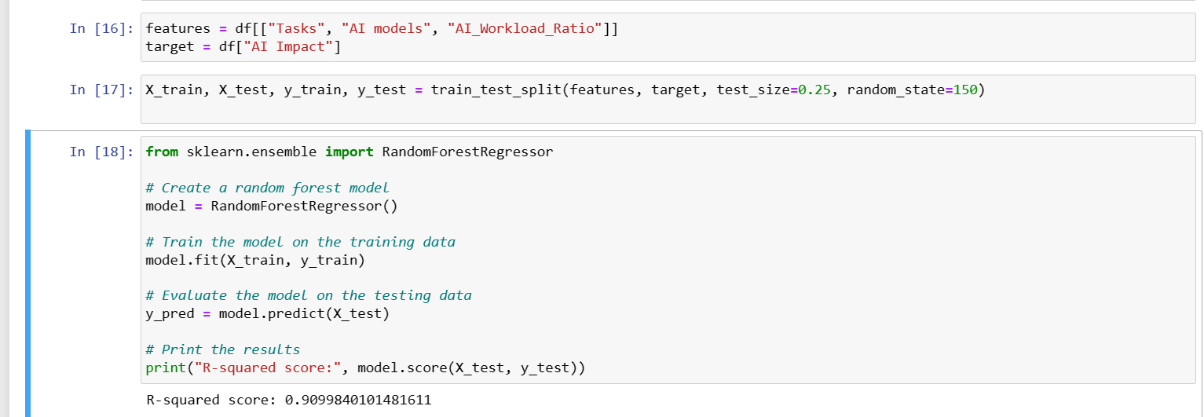
Then we have chosen random forest regression model for the execution with some input variables getting the prediction of AI Impact.

Slide 11
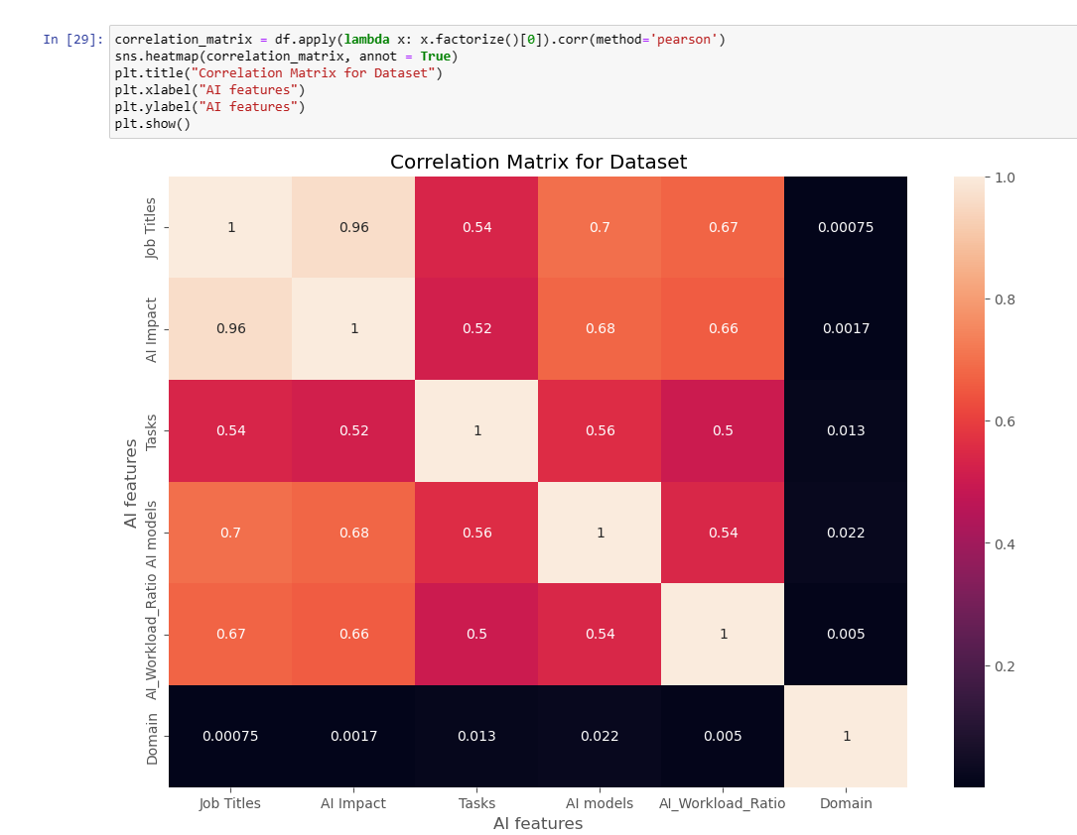

Slide 12
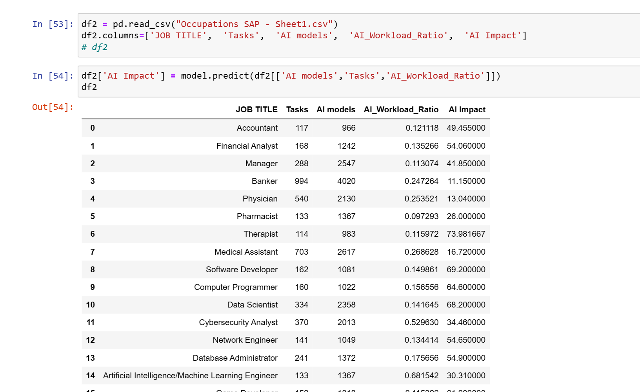
Prediction of survey data

Slide 13
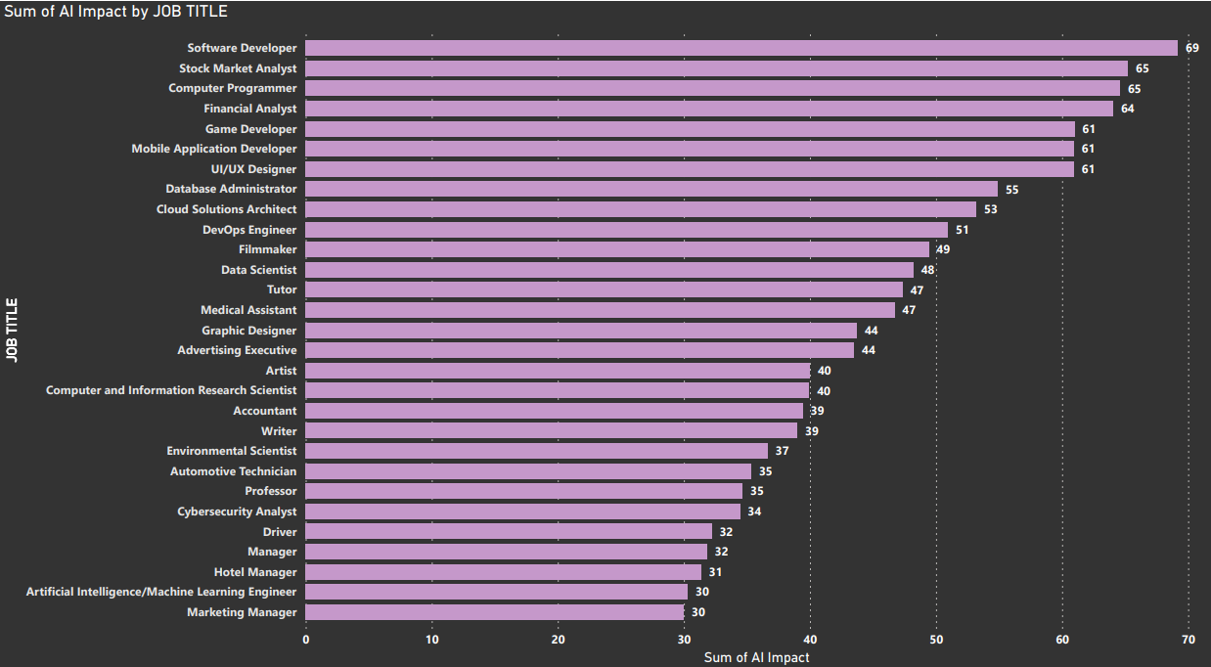
Result / Outcomes

Slide 14
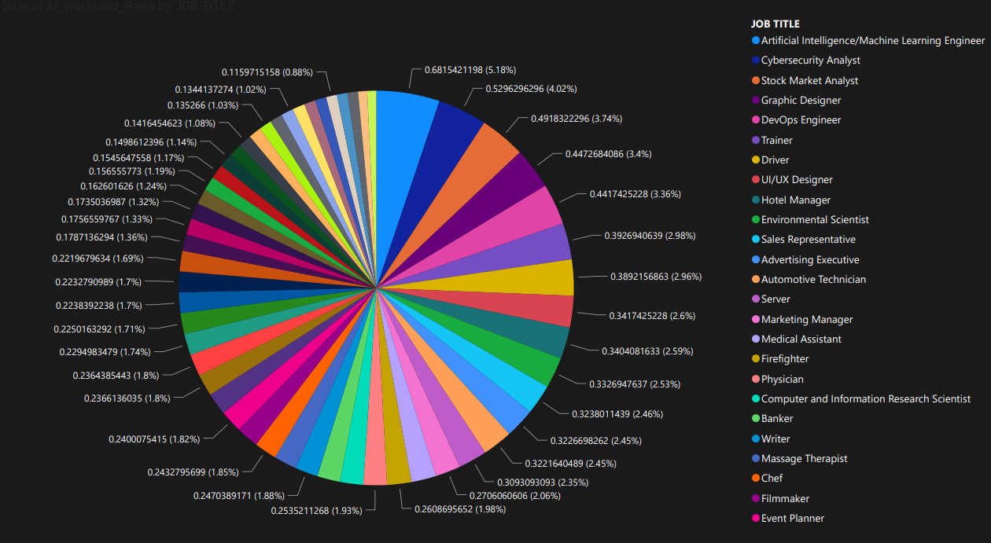
Pie chart of Job titles and Work Load Ratio

Slide 15
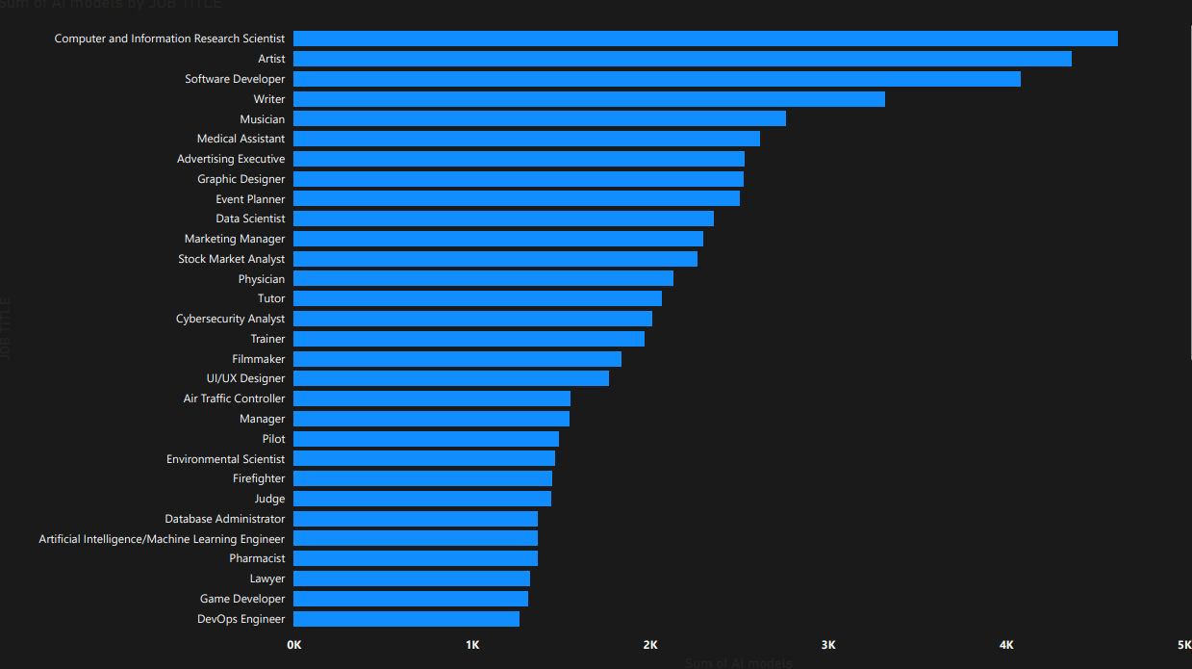
Bar graph representation of Job Title and AI models

Slide 16
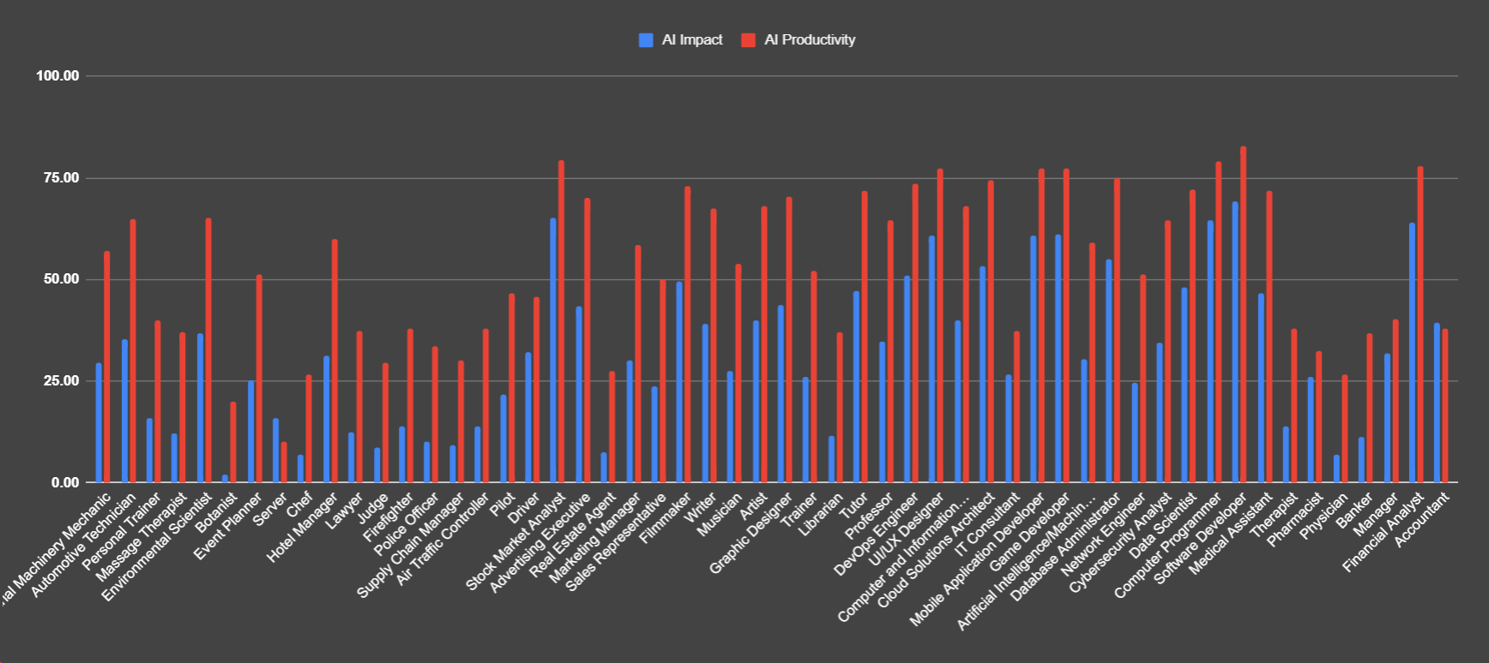
Comparison between AI impact and Productivity increased.

Slide 17
Conclusion
We have taken review from several user and predicted the impact of AI in their respective Job Fields so the average AI impact on job field is
29.39% .
“We have predicted that average productivity has increased across different fields by 57.20%.
While AI brings numerous benefits, it also has implications for productivity.

Slide 18
Future Perspective
The one who will cope up with AI and use it's features, will sustain their jobs in this competitive job world.

Slide 19
Thank you...!
Notes:
19

